Slide 1
An Optimal Algorithm for the Maximum Two-chain Problem
R. D. Lou, M. Sarrafzadeh, D. T. Lee
SIAM Journal on Discrete Mathematics, Vol. 5, Issue 2, pp. 285 – 304, 1992
Presenter: Chiou-Ting Tseng
Date: Mar. 19, 2008

Slide 2
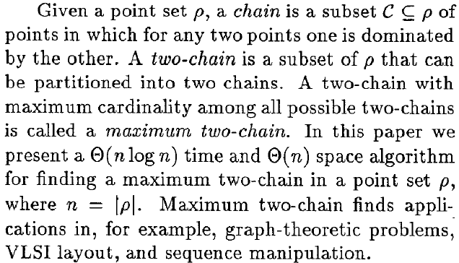
Abstract

Slide 3
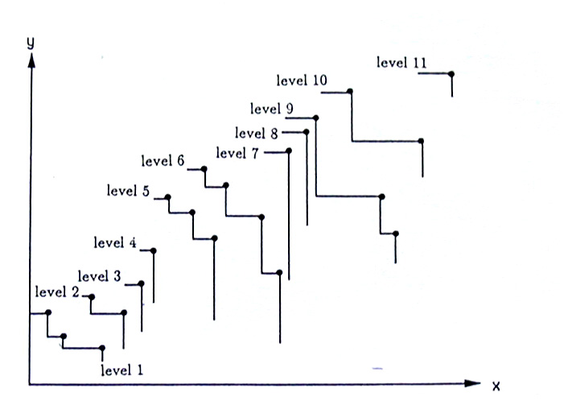
Dominance and Chain

Slide 4
Chain & Two chain
Chain: its points are pairwise noncrossing
Two-chain: it contains no three points that are pairwise crossing
A maximum chain is a chain with the maximum number of points among all chains
A maximum two-chain is a two-chain with the maximum number of points among all two-chain.

Slide 5
Level
Maxima of a points set:the points that are not dominated by any other points.
Level:all maxima form a level.Then ignore the points at this level and recursively find other maxima and level.We call the levels,from bottom to top,levels 1,2… ,s.We assign each point P_{a} a value L(a),called the L-value of point P_{a},to indicate that P_{a} is at level L(a).

Slide 6
Goal
Find 2 points in each level if possible.

Slide 7
The Simple Method to Solve the Problem?
Left-(right-)point of the level:the point with the smallest(largest) x-coordinate at a level.
Left-dominating(right-dominating)point of P_{a}:the point at level u+1 with the smallest(largest)x-coordinate among all points dominating P_{a} at level u.
Solid chain: a chain with one point at each level.
The simple method?

Slide 8
The Four Phases to Process the Points
We assume that there is a fictitious level 0 containing one fictitious point P₀=(0,0)
The four phases:
(1)local chain assignment phase
(2)N-value assignment phase
(3)candidate chain assignment phase
(4)adjustment phase

Slide 9
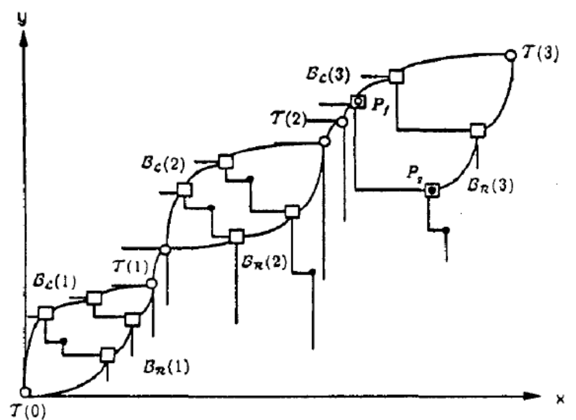
Local Chain Assignment Phase

Slide 10
Local Chain Assignment Phase
B_{L}(i),B_{R}(i),T(i) are called left branch,right branch and tie of the ith local chains,respectively.
A point in a local chain is called a marked point.
Assign P₀ to T(0)
At local chain assignment phase of level u.There are two cases:
(LC1)P_{a} at level u-1 assign to T(i):if the left-dominating point and the right-dominating point of P_{a} are distinct,assign them to B_{L}(i+1),B_{R}(i+1).Otherwise, we assign the dominating point to T(i).

Slide 11
Local Chain Assignment Phase(cont.)
(LC2)P_{a},P_{b} at level u-1 have been assigned to B_{L}(i), B_{R}(i):If the left-dominating point of P_{a} and the right-dominating point of P_{b} are distinct,then assign them to B_{L}(i),B_{R}(i);otherwise,we assign the dominating point to T(i).

Slide 12
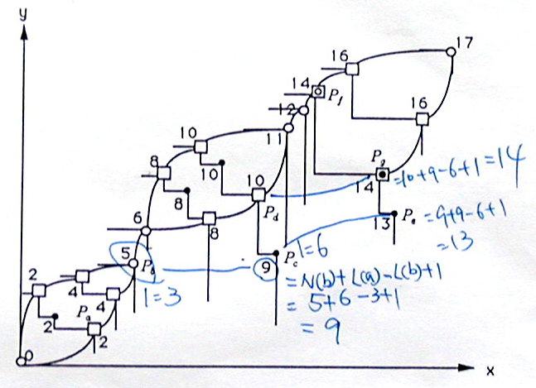
N-value Assignment Phase

Slide 13
N-value assignment phase
N-value of P_{a}:assign a value N(a)to each P_{a} at level u.
N(a) is the size of a maximum two-chain in P_{1,L(a)}
The rules:
(R1):N(0)=0 for P₀
(R2):P_{a} is in a tie,then N(a)=N(b)+1,where P_{b} is any marked point at level L(a)-1
(R3):P_{a} is in a branch,then N(a)=N(b)+2,where P_{b} is any marked point at level L(a)-1
(R4):P_{a} is unmarked,then N(a)=max{N(b)+L(a)-L(b) +1}over all P_{b} dominated by P_{a}.
Preceding point of P_{a}:the point that make N(b)+L(a)-L(b) +1 maximum.

Slide 14
Candidate Chain Assignment Phase
Candidate chain of P_{a}: for each point P_{a} at level u, construct a chain C(a) with top P_{a}.
Construct manner:
If P_{a} is marked,C(a)={P_{a}}
Otherwise,C(a)=C(b)∪{P_{a}},where P_{b} is the preceding point of P_{a}.

Slide 15
Adjustment Phase
If there exists a point P_{f} at level u belonging to a tie T(i), and there also exists some unmarked point at level u,say P_{g}, whose N-value is the largest among all unmarked points at level u and is no less than N(f), then we delete P_{f} from T(i) and set N(f)=N(g). Then assign P_{f}, P_{g} to B_{L}(i+1), B_{R}(i+1)

Slide 16
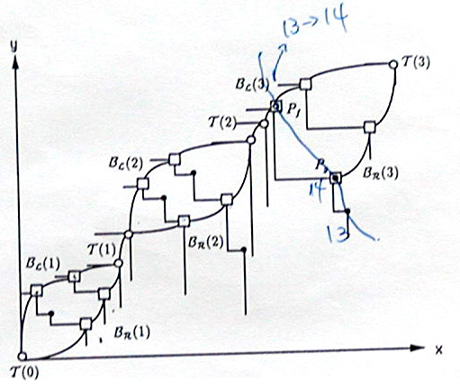
Adjustment Phase

Slide 17
Result
Correctness is omitted.

Slide 18
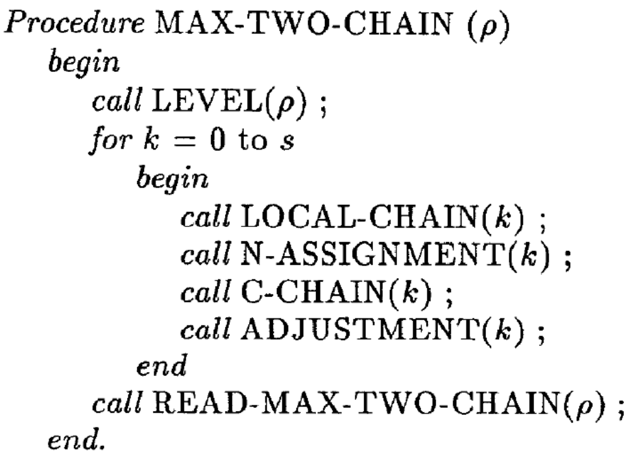
Algorithm

Slide 19
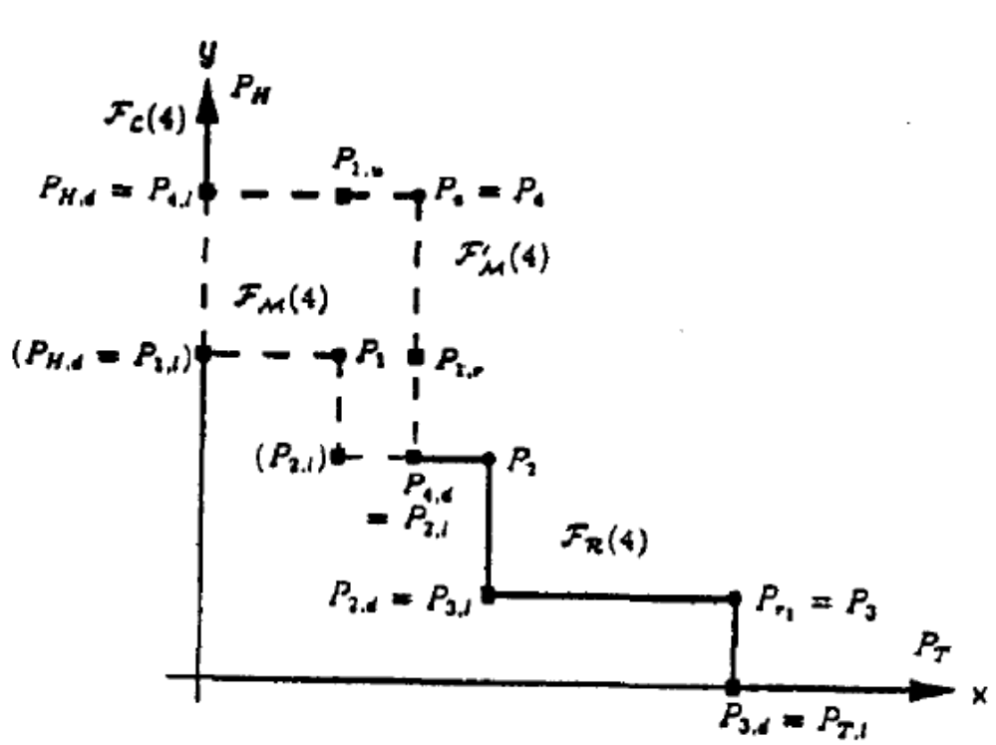
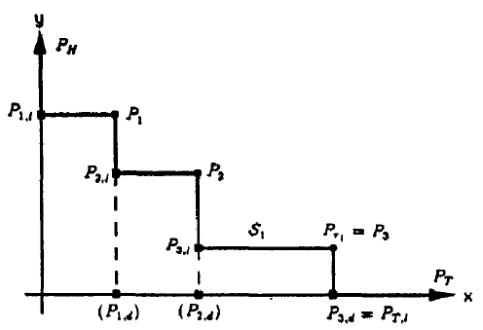
Staircase

Slide 20
N-value Assignment
We maintain a 2-3 tree for all the points P_{H}, P_{i,l}, P_{i} in ρ, P_{T,l}, and PT of S(P_{i}) such that each leaf corresponds to a point.
The leaf v corresponding to P_{i} in ρ is the root of a binary tree so that the left and right subtrees, denoted by U(P_{i}) and R(P_{i}), are height balanced and contain u-projections U_{i} and r-projections R_{i}, respectively.

Slide 21
N-value Assignment
The height balanced subtrees are maintained so that at each internal node w a weight W(w), which is equal to the maximum weight among those stored at the leaves rooted at w, is stored.
The leaf corresponding to P_{i,l}, where P_{i}∈ρ, stores the maximum weight of the points dominated by P_{i,l}.
The leaves corresponding to P_{H}, P_{T,l}, and P_{T} store weight 0.

Slide 22
Staircase

Slide 24
Further Reading
Three Chain O(nlogn) time
  Ruey-Der Lou, Majid Sarrafzadeh, “An Optimal Algorithm for the Maximum Three-Chain Problem,” SIAM J. Comput. Vol. 22, Issue 5, pp. 976-993, 1993
K-chain O(knlogn) time
  Stefan Felsner, Lorenz Wernisch, “Maximum k-Chains in Planar Point Sets: Combinatorial Structure and Algorithms,” ACM Symposium on Theory of Computing, pp. 146-153, 1993
K chain O((n²/k)logn) time
  G. Viennot, “Chain and antichain families, grids and Young tableaux,” in Orders: Description and Roles, North-Holland Math. Stud. Vol. 99, 1984

